Slide 1
Inheritance

Slide 2
Inheritance
Reusability is another feature of OOP's.
The mechanism of deriving a new class from an old one is called 'INHERTTENCE'.
The old class is called 'BASE' class and the new one is called 'DERIEVED'class

Slide 3
Defining Derived Classes
The general syntax of defining a derived class is as follows:
class d_classname : Access specifier baseclass name
{
__
// members of derived class
};

Slide 4
The colon indicates that the d-class name is derived from the base class name.
The access specifier or the visibility mode is optional and, if present, may be public, private or protected. By default it is private.
Visibility mode describes the status of derived features

Slide 5
Access specifier
Public - The members declared as Public are accessible from outside the Class through an object of the class.
Protected - The members declared as Protected are accessible from outside the class BUT only in a class derived from it.
Private - These members are only accessible from within the class. No outside Access is allowed.

Slide 6
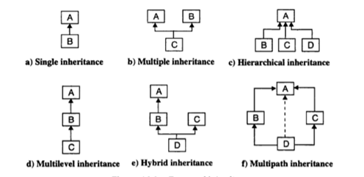
Types of Inheritance

Slide 7
Single Inheritance
A class can be derived from a single base class is called single inheritance
Person
Employee

Slide 8
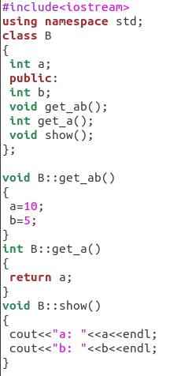
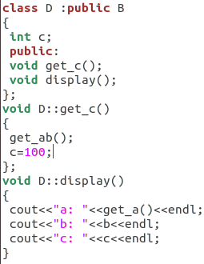
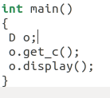

example

Slide 9
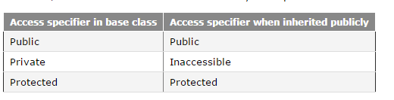
Public Inheritance

Slide 10
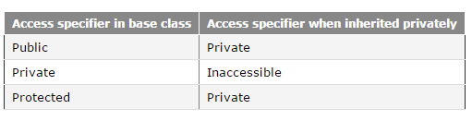
Private Inheritance

Slide 11
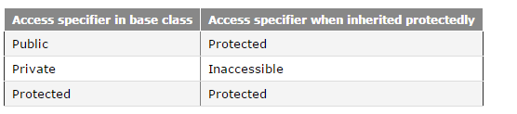
Protected Inheritance

Slide 12
Multilevel Inheritance
A class be can derived from a derived class which is known as multilevel inheritance.
Person
Vehicle
Car
Employee
Racing car
Part time Employee

Slide 13
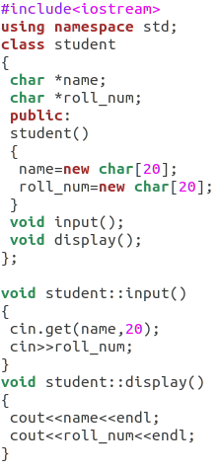
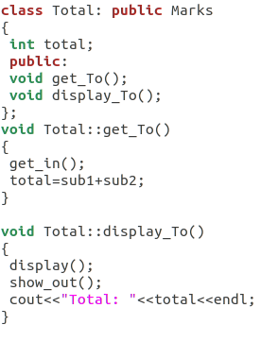
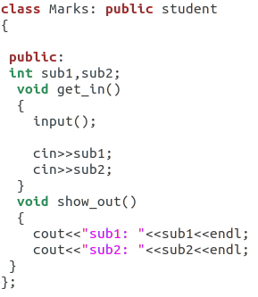
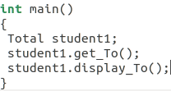
example

Slide 14
Multiple Inheritance
It is the process of creating new class from more than one base classes.
Syntax :
class <derived class >:<access specifier>
base_class1,<access specifier> base_class2...
{
private :
// members;
protected :
// members;
public :
//memebers;
};
Person
Employee
Teacher

Slide 15
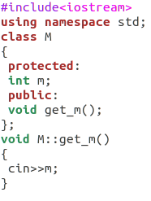
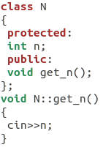
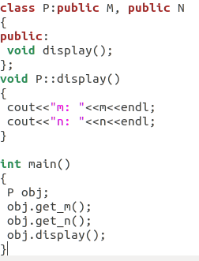
example

Slide 16
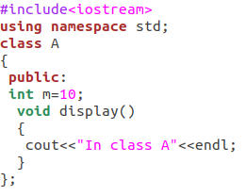
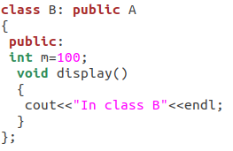
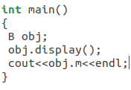
Same Data Member Name in Base and Derived Class

Slide 17
Hierarchical Inheritance
If more than one class is inherited from a base class, it's known as hierarchical inheritance. In general, all features that are common in child classes are included in base class in hierarchical inheritance.
Employee
Permanent Employee
Temporary Employee

Slide 18
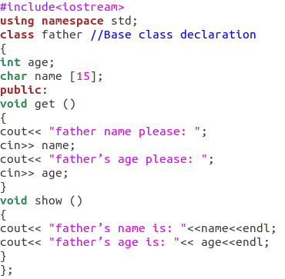
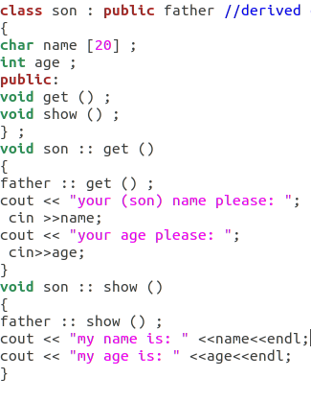
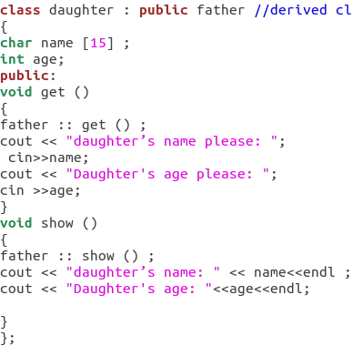
example

Slide 19
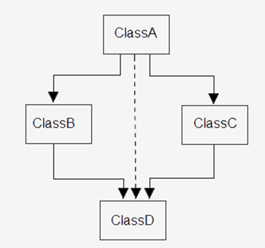
Multipath Inheritance
A derived class with two base classes and these two base classes have one common base class is called multipath inheritance.

Slide 20
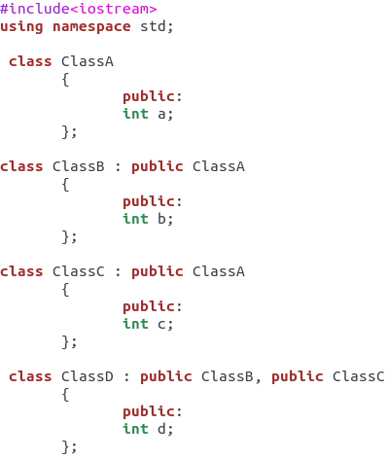
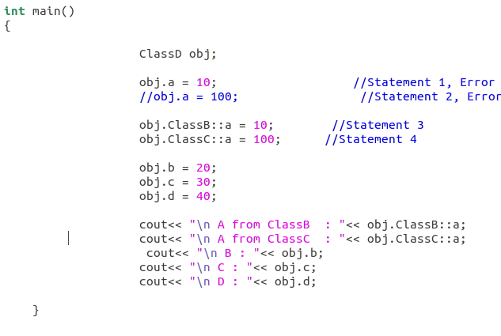
Example

Slide 21
Hybrid Inheritance
Hybrid is nothing but the combination of Multilevel and multiple Inheritance

Slide 22
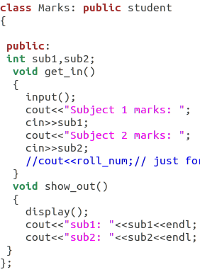
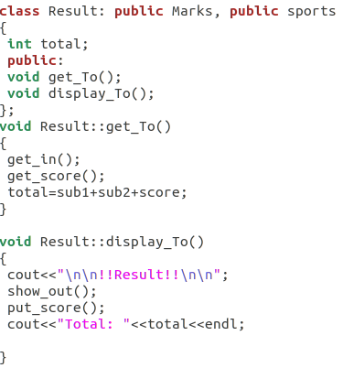
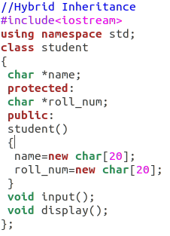
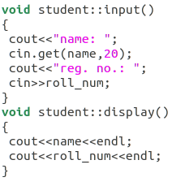
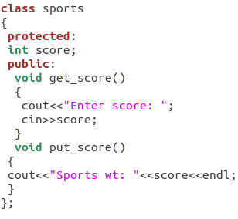
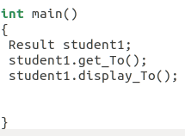

Slide 23
Order of Constructor Call
Base class constructors are always called in the derived class constructors. Whenever you create derived class object, first the base class default cpnstructor is executed and then the derived class's constructor finishes execution.
Points to Remember
Whether derived class's default constructor is called or parameterised is called, base class's default constructor is always called inside them.
To call base class's parameterised constructor inside derived class's parameterised constructo, we must mention it explicitly while declaring derived class's parameterized constructor.

Slide 24
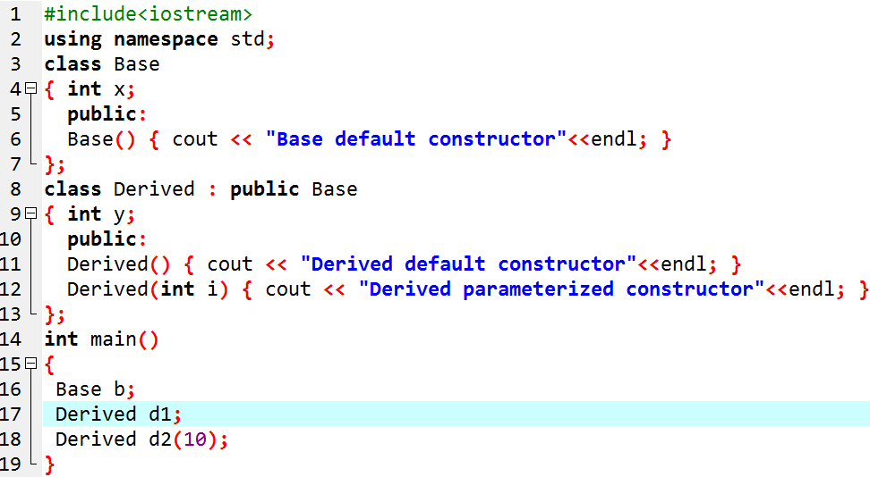

Slide 25
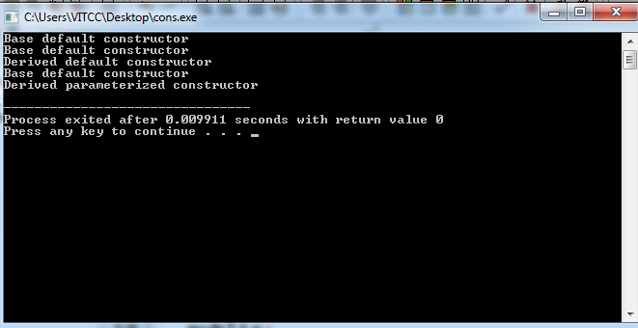

Slide 26
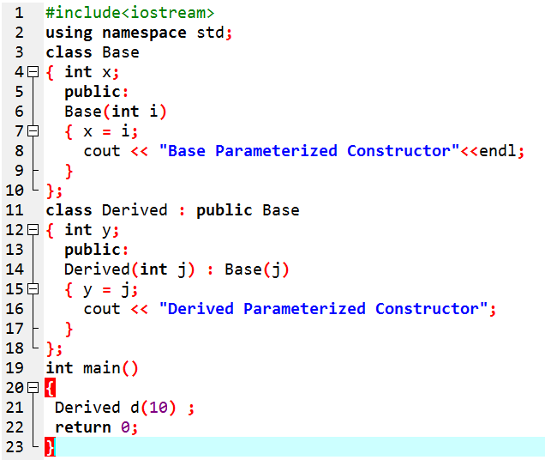
Base class Parameterized Constructor in Derived class Constructor
We can explicitly mention to call the Base class's parameterized constructor when Derived class's parameterized constructor is called.

Slide 27
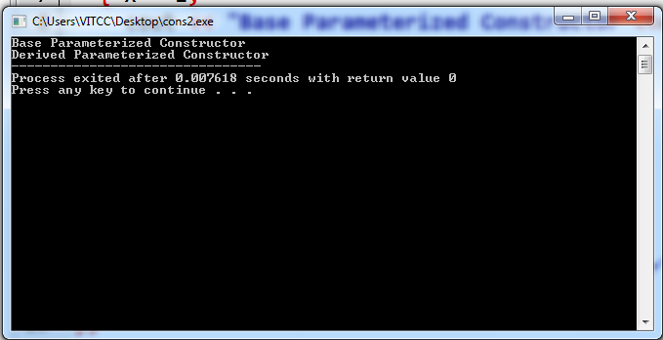

Slide 28
Constructor call in Multiple Inheritance
Its almost the same, all the Base class's constructors are called inside derived class's constructor, in the same order in which they are inherited.
class A : public B, public C ;
In this case, first class B constructor will be called, then class C constructor and then class A constructor.

